Slide 1
Data Driven E-commerce Case Study for Olist
-Aditi Ganesh Joshi, Ashish Murlidhar Pagote, Surbhi Garg

Slide 2
Agenda
Olist Overview: Company Insights Key operations and datasets
Business Goals
Data Manipulation and Transformation using Excel Power Query Feature Generation Sorting Aggregation Merges So on…….
Data Visualization using Tableau Seller Analysis
Product Analysis Customer Analysis
Conclusion and Recommendations

Slide 3

About Olist
-Connects SMBs with customers through its Online Marketplace -Founded in 2015, Brazil by Tiago Dalvi -45000+ shopkeepers and retail stores as client -Areas of operation: Brazil, Mexico -Was valued at $1.5 Billion in 2021

Slide 4
Key operations and datasets
Order items
Orders
Product-Side
Products
Product Category Translation
Seller-Side
Sellers
Marketing
Closed Deals
Marketing Qualified Leads
Customer-Side
Customers
Order Payment Details
Order reviews
Order Management
(Order purchase, payment)
Olist Ops.
Seller Marketing
(Reach out to sellers via different channels, campaigns)
Seller Operations
(Shipping and Packaging)
Post Order Journey
(Order feedback and reviews)

Slide 5
Business Goals
Data-driven analysis of an e-commerce firm in Brazil called “Olist”. Olist provides a marketplace for various SMBs to sell their products online. The aim of this project is divided into four parts as follows:
Sellers and Seller-Marketing Analysis
Understand the logistics and address inefficiencies by using seller performance data
Identify high impact sellers by analyzing sales metrics
Identify channels of marketing and quantify conversion metrics
Products Analysis
Perform exploratory data analysis on order data to identify the most frequently bought products, product categories, etc.
Conduct Market Basket Analysis on the e-commerce data to understand consumer behavior
Analyze trends and forecast future sales
Customer and Payment Analysis
To study the customer share across different regions of the country
Understand the modes of payments used the customer base and by how much

Slide 6
Data Manipulation & Transformation - Excel Power Query
Seller-Side
Data Source | Size (#rows) | Primary Keys
Order Items | 112.6k | order_id, order_item_id, product_id
Orders | 99.4k | order_id and customer_id
Sellers | 3.1k | seller_id

Slide 7
Data Manipulation & Transformation - Excel Power Query
Seller Side Feature Generation and Cleaning - Orders Dataset
Time Difference between actual time of delivery and estimated time of delivery in days
Order Breach Flag (1 or 0)
Imputed Breach flag with 0 where delivery date was not available.
Merging, Feature selection and generation - Order Items Dataset
Merged with Orders dataset
Kept relevant columns (Shipping limit time, Breached Flag etc.)
Created Time to Ship using order purchase time and shipping limit time
Aggregated all the metrics at seller level Metrics: Orders,Unique Orders,Breached Orders,Total Revenue,Total Freight Value,Average Shipping Time
Calculate breach percentage orders by dividing breached orders by total orders

Slide 8
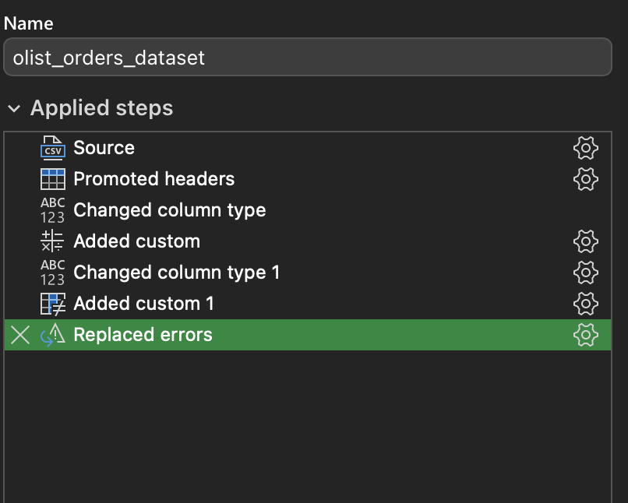
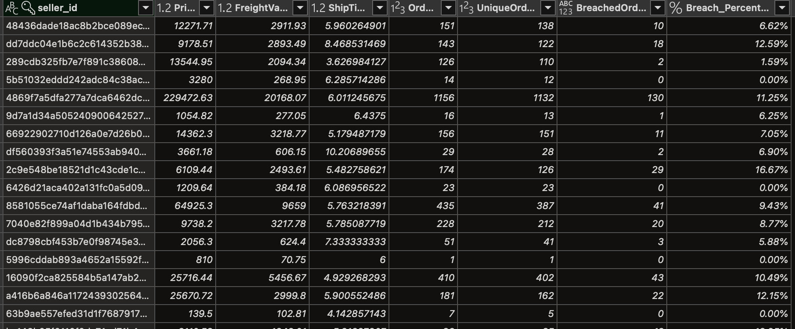
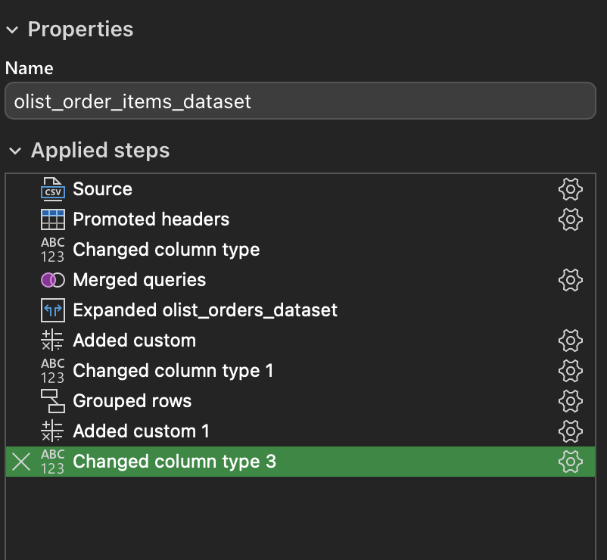
Power Query Snapshot- Query Editor and Seller level DB

Slide 9
Data Manipulation & Transformation - Excel Power Query
Seller-Marketing Side
Data Source | Size (#rows) | Primary Keys
olist_marketing_qualified_leads | 8k | mql_id
Orders | 0.8k | mql_id

Slide 10
Data Manipulation & Transformation - Excel Power Query
Seller Marketing Side Feature Generation and Cleaning - Marketing Dataset
Converted or Not Flag
Time to convert
Aggregate at origin level to obtain converted leads, total leads and average time to convert
Calculate conversion rate by converted leads and total leads
Filtration of unknown origins

Slide 11
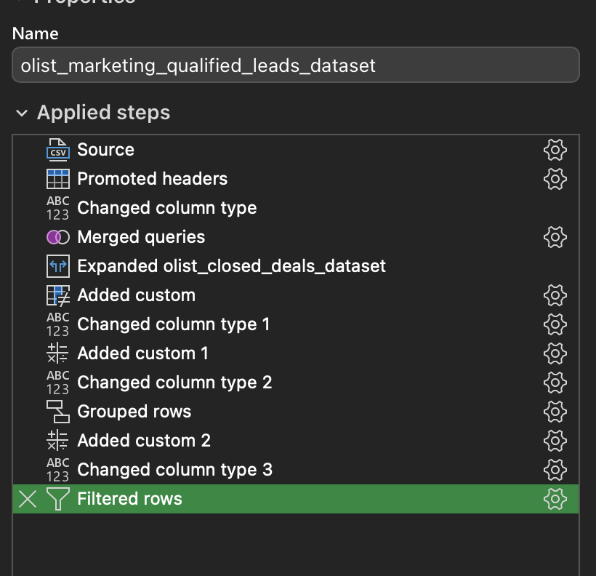
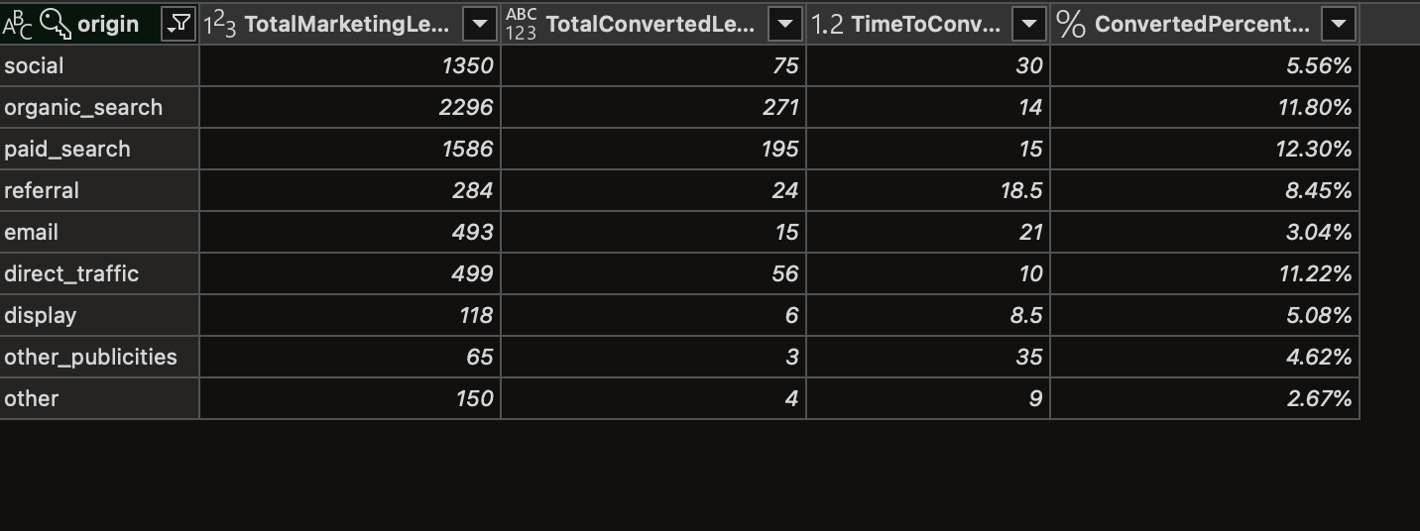
Power Query Snapshot- Query Editor and Marketing DB

Slide 12
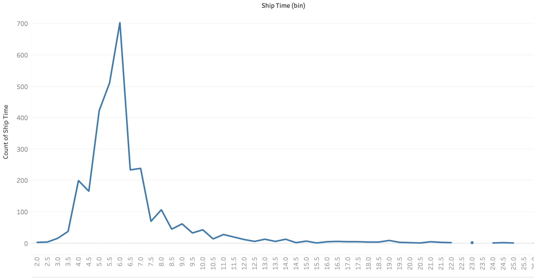
Data Visualisation using Tableau
Seller Analysis- Distribution of shipping time (Median around 6 days)

Slide 13
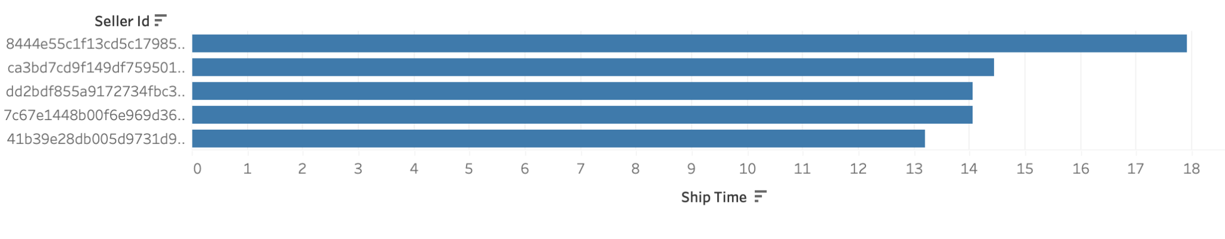
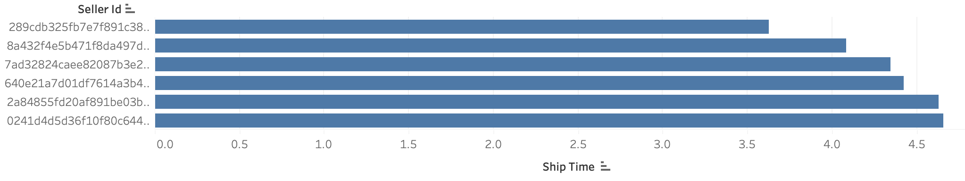
Data Visualisation using Tableau
Seller Performance- High Ship Time (Minimum 100 orders)
Seller Performance- Low Ship Time (Minimum 100 orders)

Slide 14
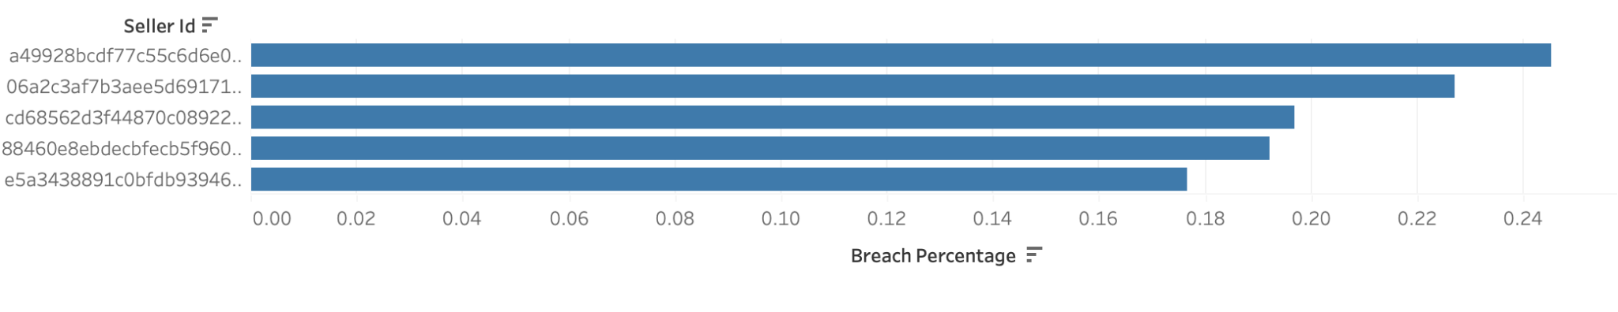
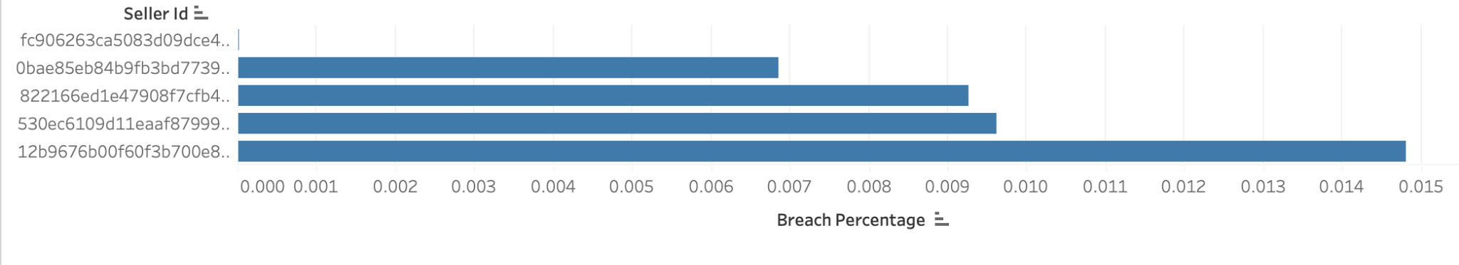
Data Visualisation using Tableau
Seller Performance- High Breach Percentage(Minimum 100 orders)
Seller Performance- Low Breach Percentage (Minimum 100 orders)

Slide 15
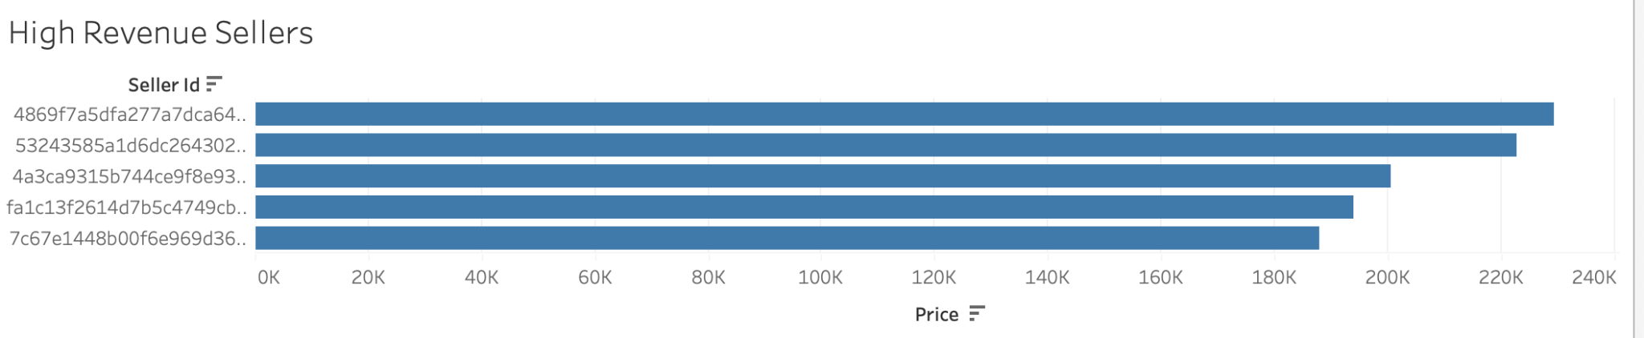
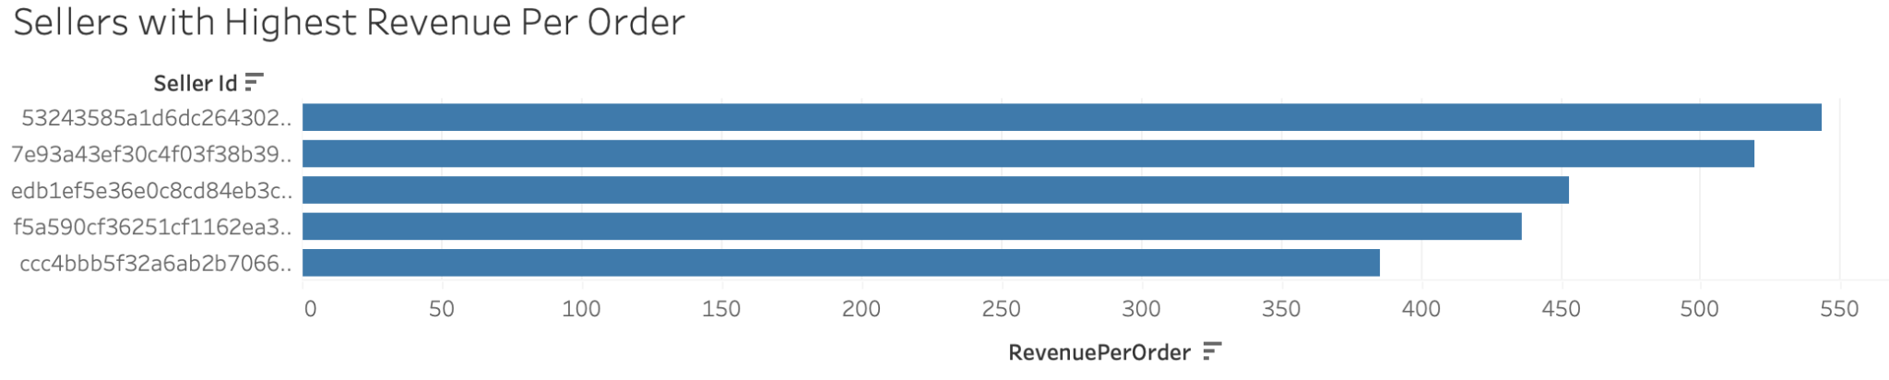
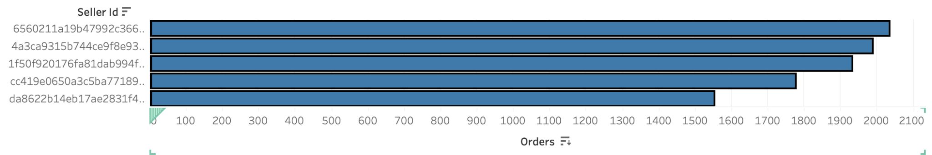
Data Visualisation using Tableau
Seller Performance- Highest Revenue, Orders and Revenue per Orders

Slide 16
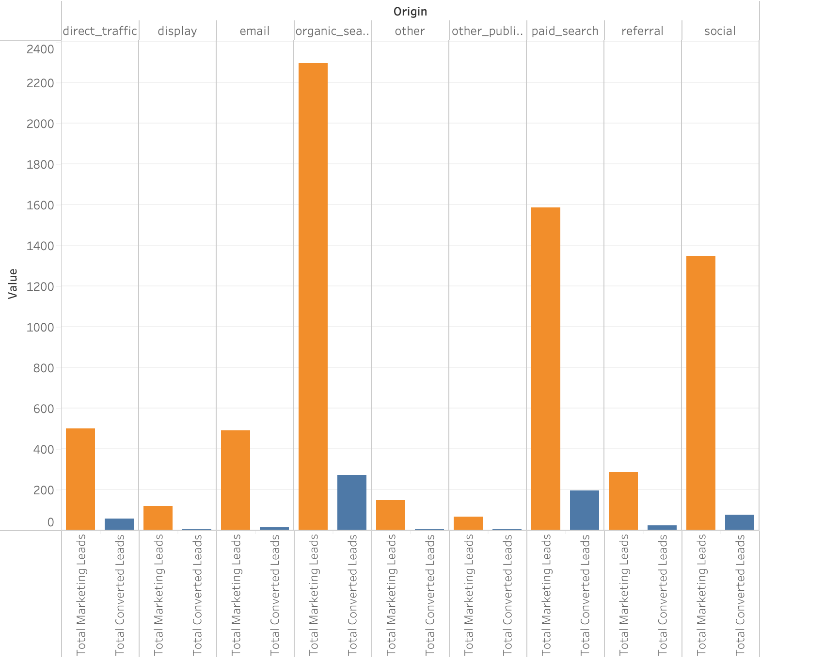
Data Visualisation using Tableau
Marketing Performance - Marketing Leads and Converted Leads

Slide 17
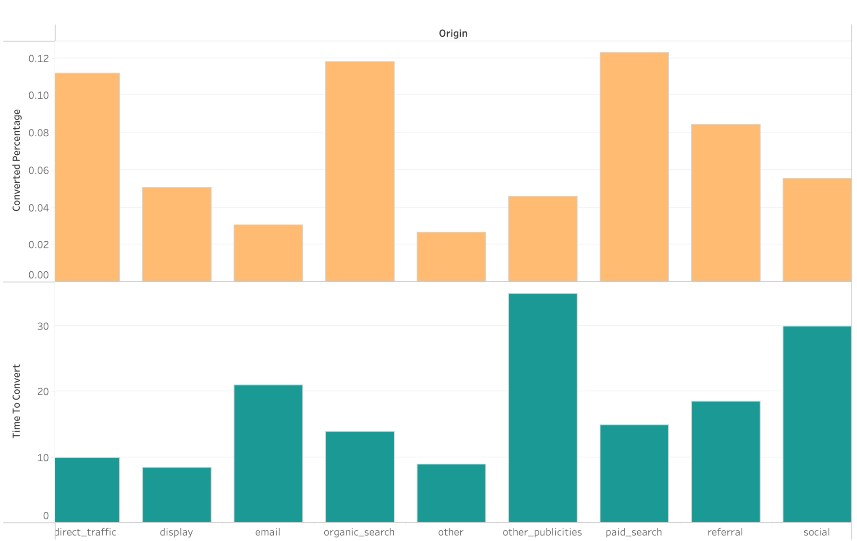
Data Visualisation using Tableau
Marketing Performance - Conversion Rate and Time to convert

Slide 18
Data Manipulation & Transformation - Excel Power Query
Product-Side
Data Source | Size (#rows) | Primary Keys
Order Items | 112.6k | order_id, order_item_id, product_id
Orders | 99.4k | order_id and customer_id
Products | 33k | product_id
Product Category Translation | 72 | product_category_name

Slide 19
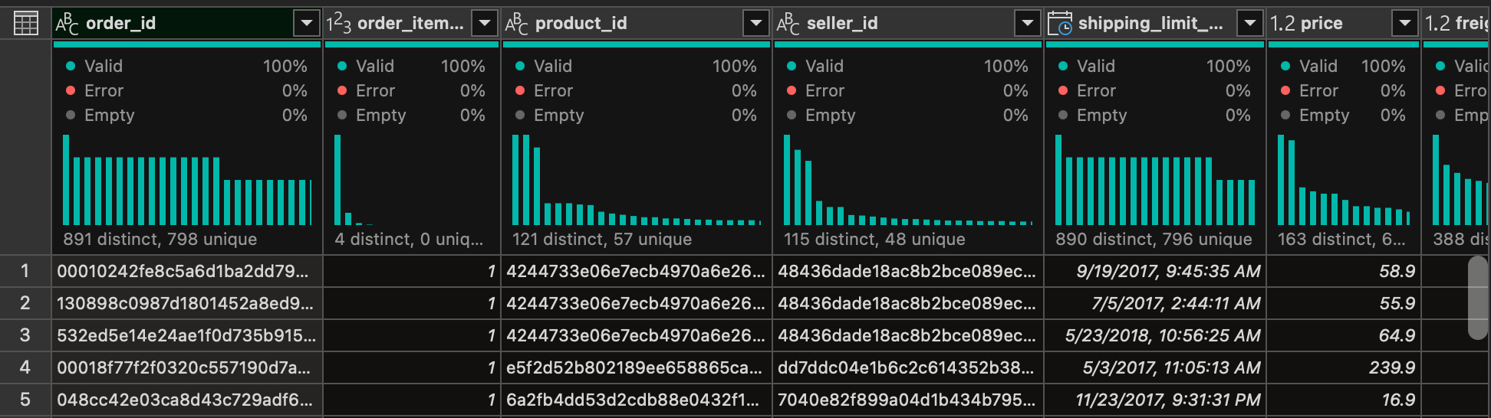
Data Manipulation & Transformation - Excel Power Query
Product Side
Data Quality Checks
No duplicates found with respect to primary keys
Excel Power Query Insights on Column Quality - ensured non-nulls for relevant columns

Slide 20
Data Manipulation & Transformation - Excel Power Query
Product Side
Feature Generation - Orders Dataset
Time For Approval - Difference between purchase time and time when the order was approved (in min)
Delivery Time - Time required for delivery starting from purchase time
Delay - Difference between actual time of delivery and estimated time of delivery

Slide 21
Data Manipulation & Transformation - Excel Power Query
Product Side
Data Integration
Dataset 1 | Dataset 2 | Key | Join Type | Details
Order Items | Orders | order_id | Left | All entries matched
Products | Product Category Translation | product_category_name | Left | 32.33k out of 32.95k matched
Order Items | Products | product_id | Left | All entries matched

Slide 22
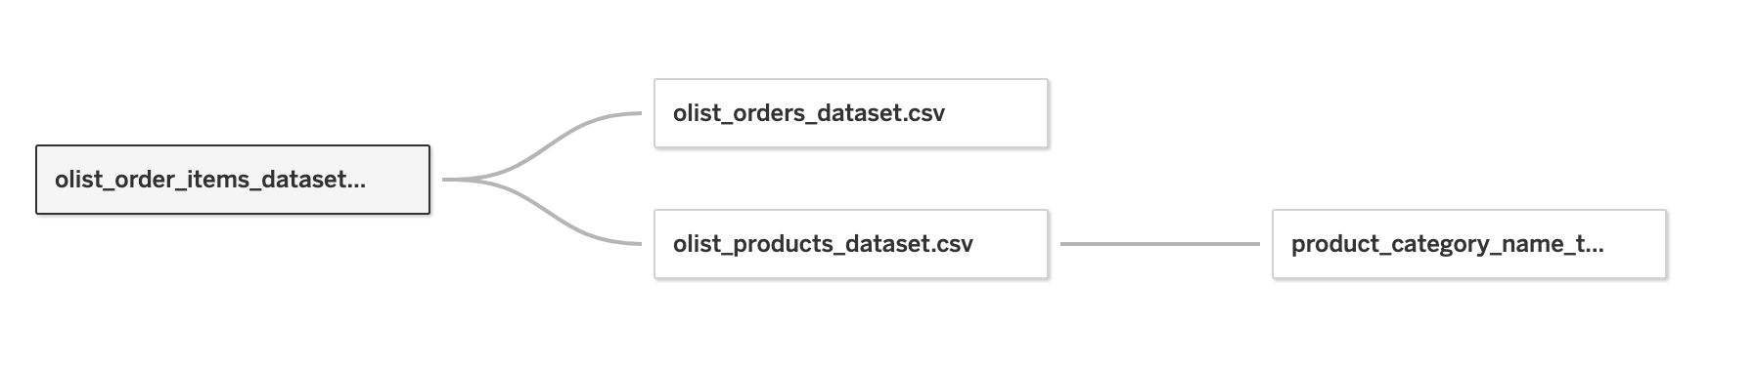
Data Manipulation & Transformation - Excel Power Query
Product Level - Data Integration

Slide 23
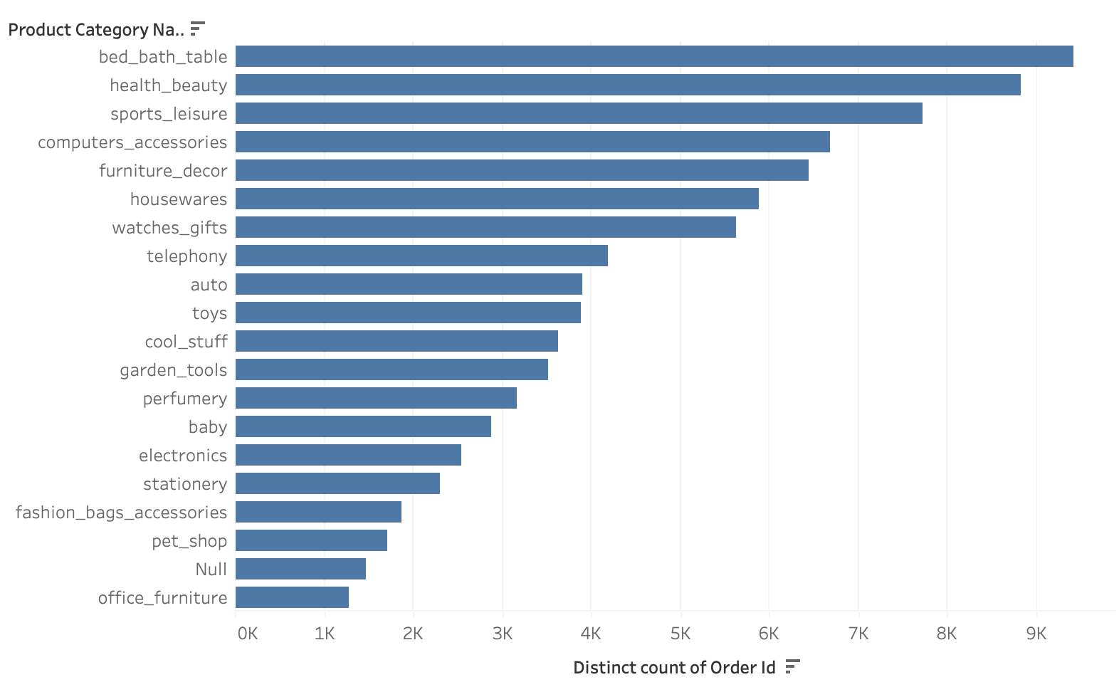
Data Visualisation using Tableau
Product Analysis - Top 10 Product Categories

Slide 24
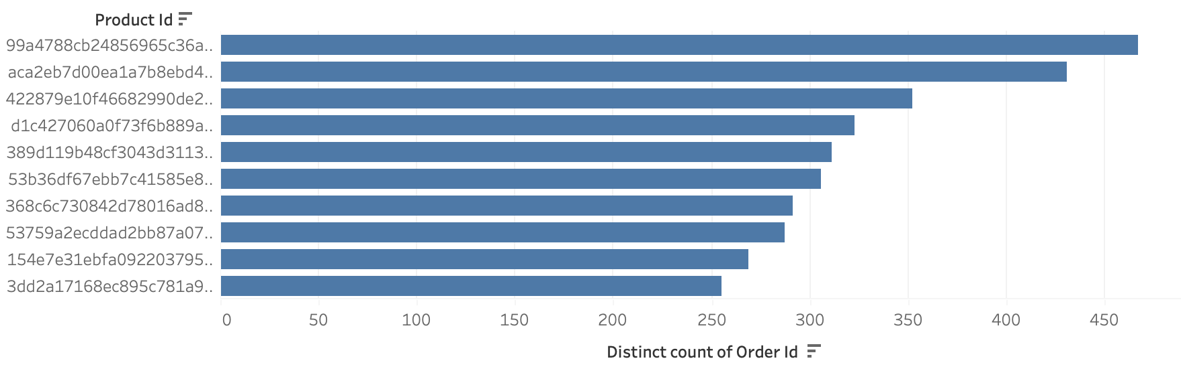
Data Visualisation using Tableau
Product Analysis - Top 10 Products

Slide 25
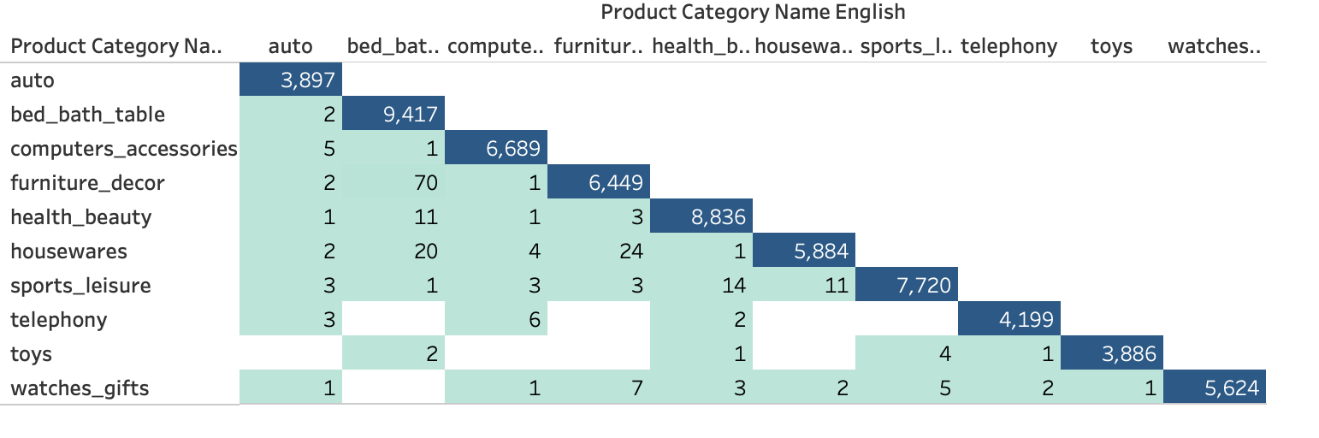
Data Visualisation using Tableau
Product Analysis - Market Basket Analysis

Slide 26
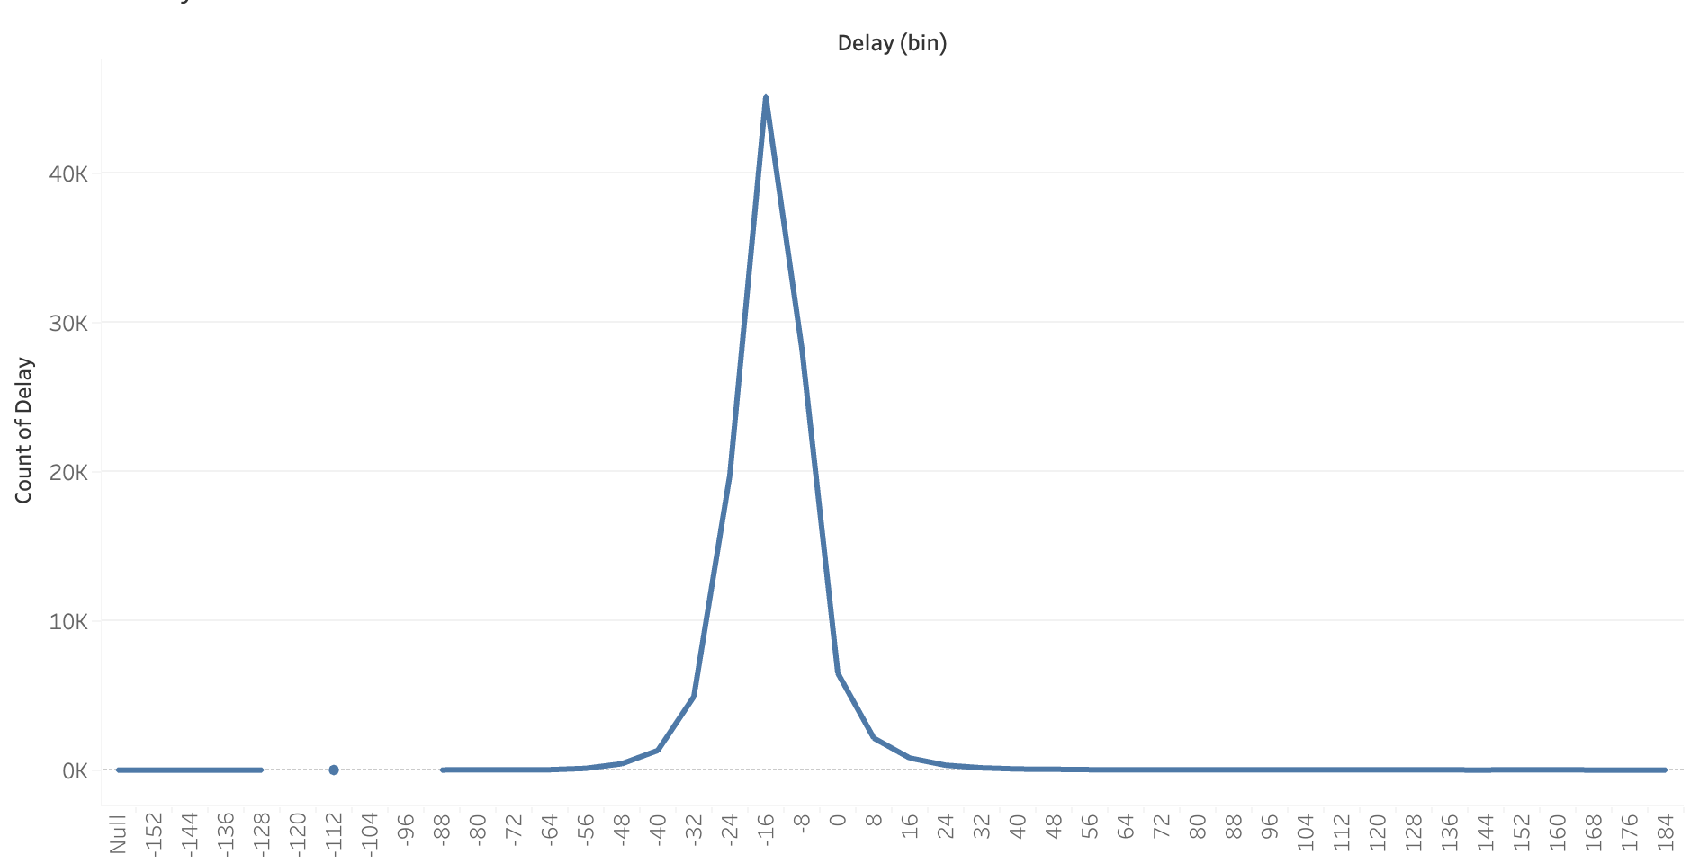
Data Visualisation using Tableau
Delay Distribution

Slide 27
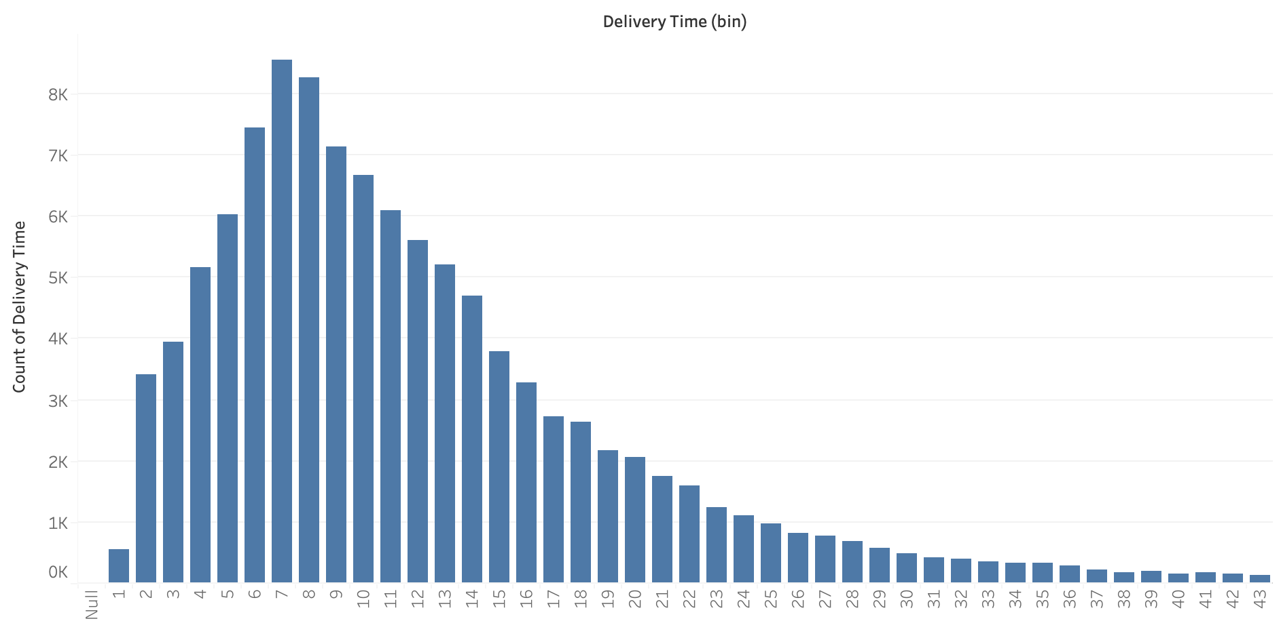
Data Visualisation using Tableau
Delivery Time Distribution

Slide 28
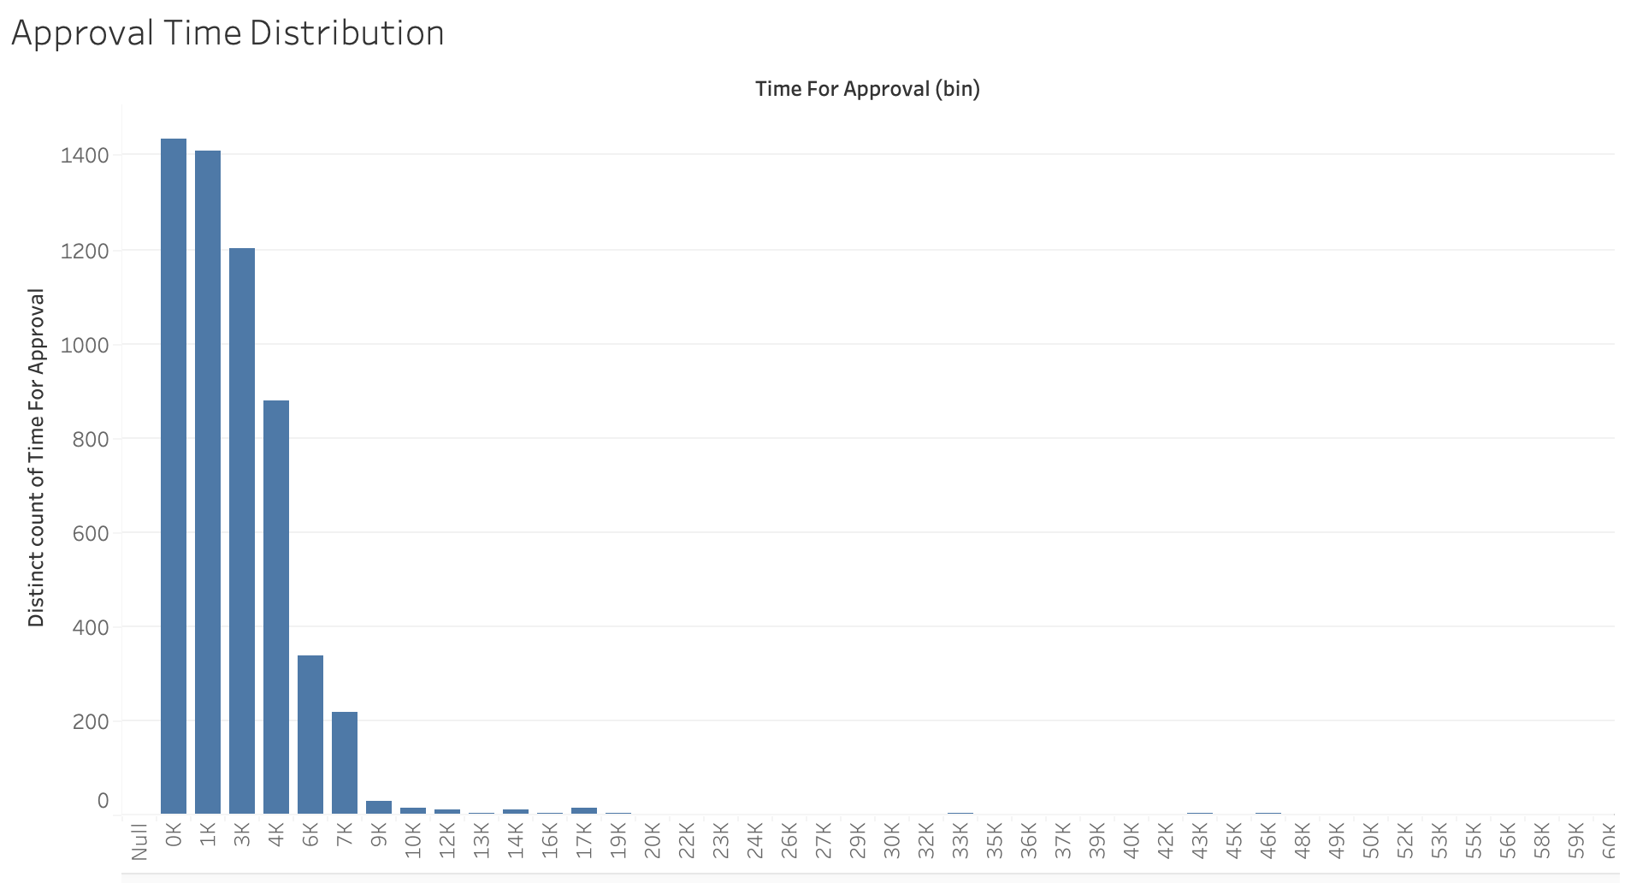
Data Visualisation using Tableau
Approval Time Distribution

Slide 29
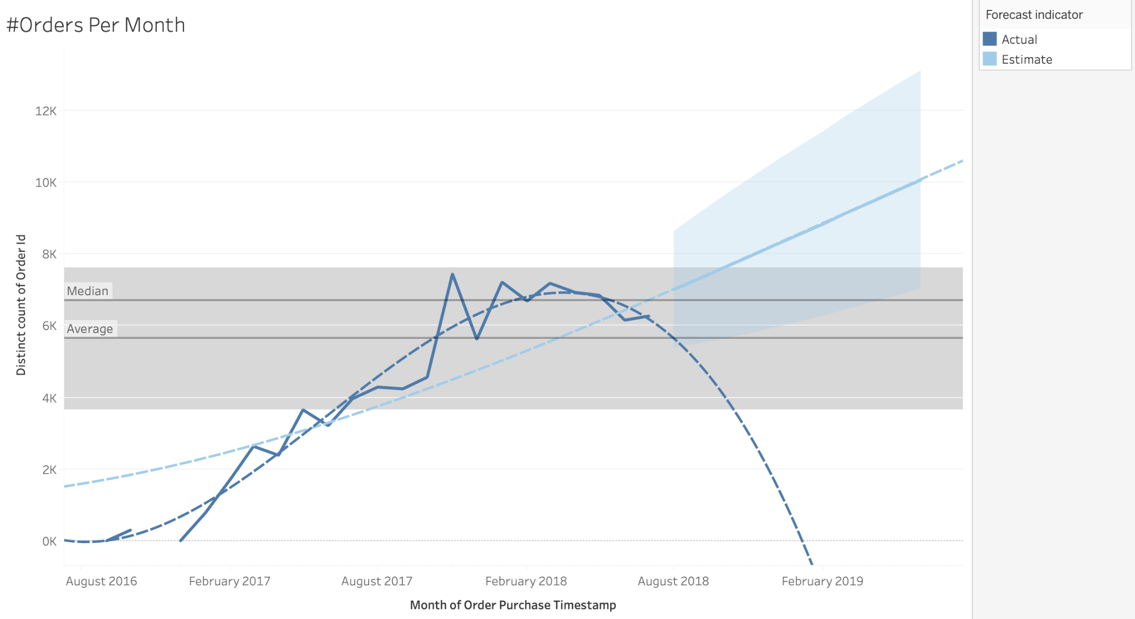
Data Visualisation using Tableau
Product Analysis - Trends in #Orders over time

Slide 30
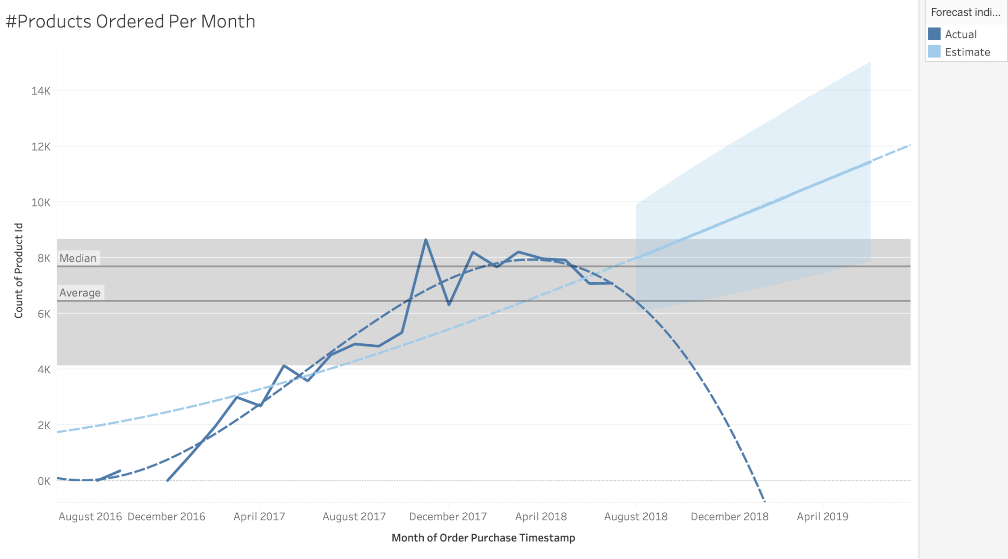
Data Visualisation using Tableau
Product Analysis - Trends in #Products Ordered over time

Slide 31
Data Manipulation & Transformation - Excel Power Query
Customer - Side
Data Source | Size (#rows) | Primary Keys
customers | 99.44k | customer_id
Payments | 116.34k | order_id, payment_type, payment_sequence, payment_installments, payment_value
Reviews | 116.34k | Order_id, review_id

Slide 32
Data Manipulation & Transformation - Excel Power Query
Customer Side
Merging, Feature Generation and Selection - customers
Merged payments dataset with reviews dataset on order_id
Took average of reviews to get unique set of rows based on the columns: order_id, payment_type, payment_sequence, payment_installments, payment_value
Removed irrelevant columns review comments, order_dates etc

Slide 33
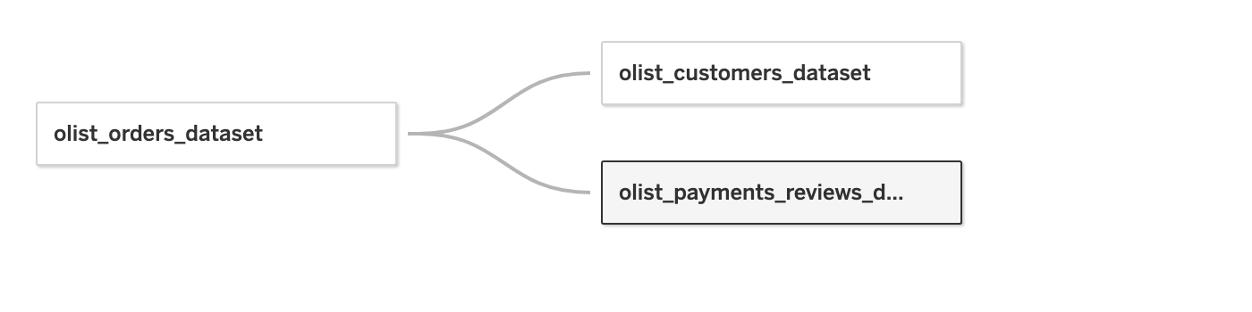
Customer Level Analysis
Data Integration

Slide 34
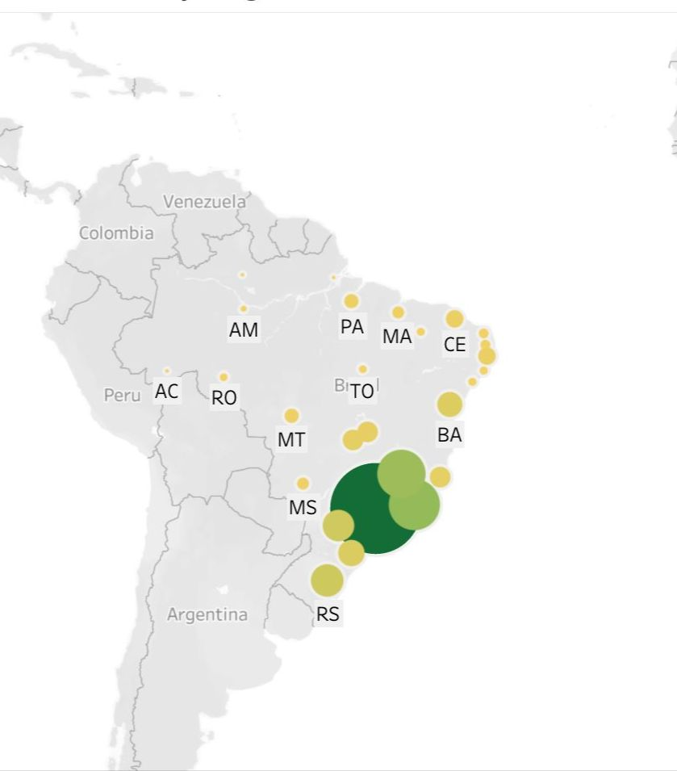
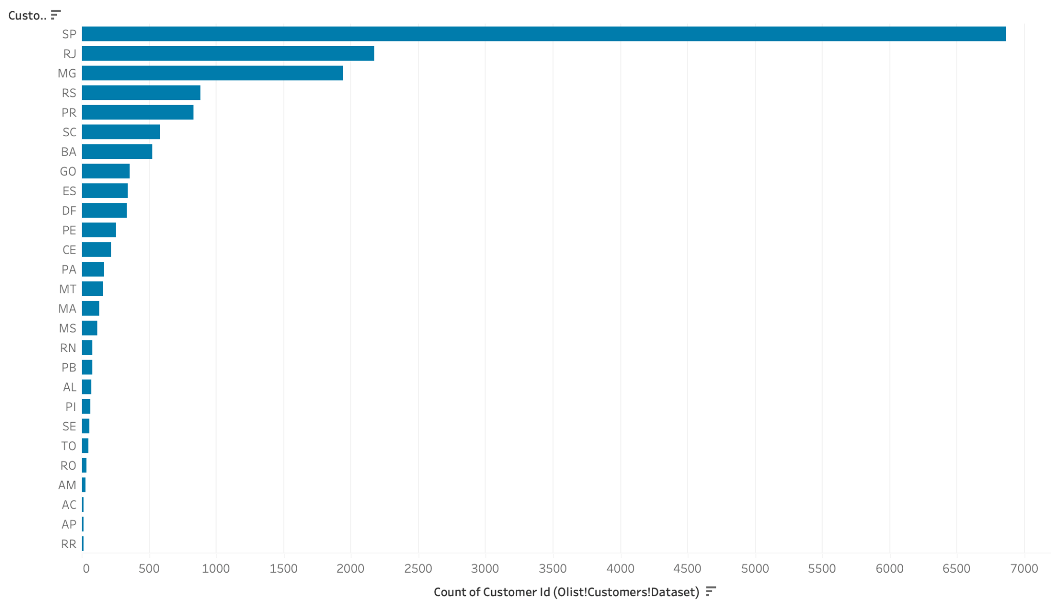
Data Visualisation using Tableau
Customer Analysis

Slide 35
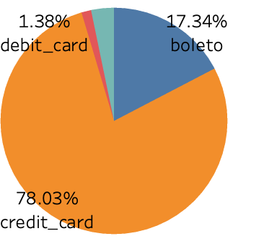
Data Visualisation using Tableau
Payment Analysis

Slide 36
Conclusion and Recommendations
Identified high selling product and product categories on the Olist platform.
Performed cross category analysis, and observed few cross selling patterns.
Identified the estimated time of delivery are generally higher than actual delivers and hence there are lot of early deliveries. Olist can promise a faster delivery, which might increase their conversion rates.
Analyzed average order approval time and delivery time which can be used with other features to improve the prediction of estimated time of delivery in future.
Analyzed sales pattern and created linear trends to forecast sales that can be used for better planning (traffic and inventory)
Identified sellers with low and high performance in terms of shipping time and delayed deliveries. Olist should develop strategies and incentives to identify the root cause of these problems and mitigate delayed deliveries to restore customer satisfaction
Identified high impact sellers in terms of revenue and orders. Olist should strengthen its partnership with these brands and sellers as they highly contribute to its business.
Organic search and direct traffic have high conversion rates. On inorganic side, Paid Search turns out to be a best channel for marketing.
Customers have high affinity for credit card as evident by its lion share in the pie chart. Olist can partner with the Credit Card Companies to promote various deals on the platform.
Sao Paulo is the biggest market for Olist. Huge gap between Sao Paulo and next best state. Olist can focus on expanding its market by acquiring more customers and sellers in other states

Slide 37
Thank You

